Slide 1

A Proposed Database Solution for
Morning Nosh Cereal HR Department
Buffalo IT Consulting, LLC
Using IT to Bring about Positive Change

Slide 2

Buffalo IT Consulting Project Team:
Ava Hintz | Vikki Hirschey
Joseph Idowu | Todd Nelson
Jordan Piershalski | Vladyslav Varian

Slide 3

About Buffalo IT Consulting
A leading innovator in the realm of Information Technology. We specialize in crafting cutting-edge database systems that redefine the way companies manage their data assets. Our tailored solutions are meticulously designed to empower businesses with scalable, secure, and high-performance databases.
Our team of seasoned IT professionals excels in creating customized database systems tailored to meet the unique needs of each client. From small businesses to large enterprises, we provide comprehensive solutions that streamline data storage, retrieval, and management processes.
Our Primary solutions emphasize scalability, security, optimizing performance, user-friendly interfaces, customization, compliance, and ensuring reliability.

Slide 4

Narrative Description
Company Name: Mornin Nosh Cereal Co.
Primary Users: HR managers and HR generalists.
Stakeholders: 300 employees across five departments: Software Development, Systems Administration, Product Management, Quality Assurance, and IT Support.
Challenges: Manual processing, errors, and delays.
Proposed Solution: An intuitive, secure, efficient and scalable HR database.
Jobs: Production Workers/Operator, Quality Control Inspectors, Machine Operators, Packaging Operators, Maintenance Technicians, Warehouse Workers, Food Scientists/Food Technologists, Quality Assurance Specialists, Logistics and Distribution Personnel, Sanitation Workers, Supervisors and Managers, Research and Development (R&D) Specialists

Slide 5

manual processing, errors, and delays have become bottlenecks in their HR processes
Current System Challenges
Performance Limitations: Inefficient query processing and indexing hinders the system's ability to handle a large volume of data.
Data Retrieval: Inefficiency in altering or retrieving employee data
Security Vulnerabilities: Lack of encryption and other security protocols could expose sensitive data to unauthorized access.
Limited Scalability: Hinders the ability to adapt to business growth and changing data requirements.
Compatibility Issues: The older system can impede on the adoption of new technologies and tools.
Increased Total Cost: Despite initial lower costs, the long-term expenses associated with maintaining and upgrading outdated systems can be higher than investing in modern, more efficient solutions.

Slide 6

Proposed System Features
Centralized System: Alleviate bottlenecks
Secure and Efficient: Reduce manual processing, minimize errors
Digital Storage: Introduce digitally stored performance reviews
Integration: Seamless integration with existing database infrastructure
Enhance human resources management capabilities
Offers a combination of operational efficiency and legal compliance.

Slide 7

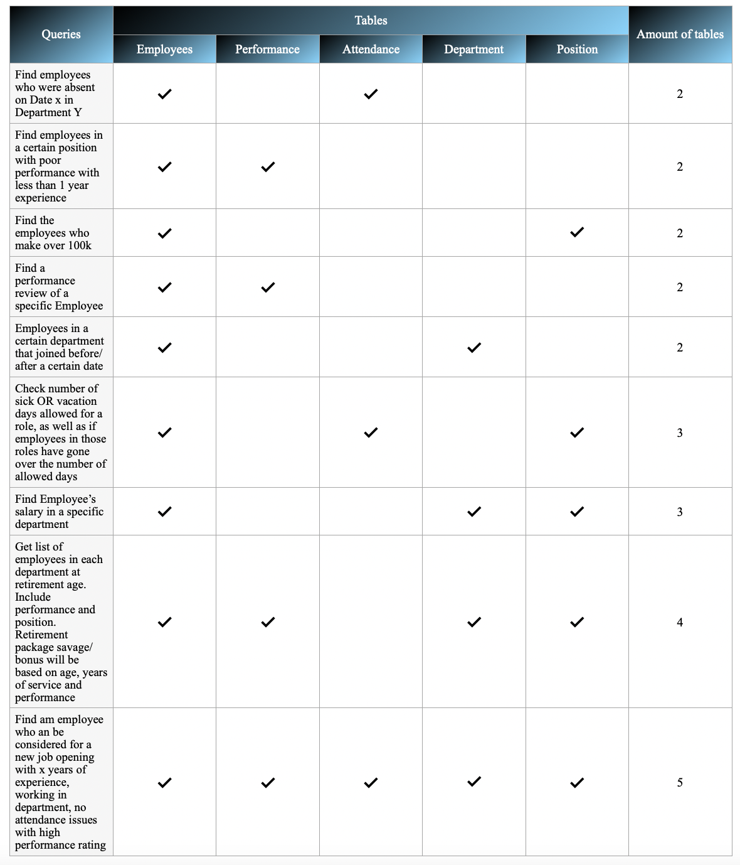

Slide 8

Entities:
3. Position
This table outlines different positions or titles within the company along with their basic salary and job description.
PositionID (PK), PositionTitle, Salary, JobDescription
4. Attendance
This table keeps track of employee attendance.
AttendanceID (PK), EmployeeID (FK), Date, Status
5. PerformanceReview
This table stores performance reviews for employees.
ReviewID (PK), EmployeeID (FK), ReviewDate, PerformanceRating, Comments
Employees
This table stores basic information about each employee.
EmployeeID (PK), FirstName, LastName, DateOfBirth, DateOfJoining, PositionID (FK), DepartmentID (FK), Email
Department
This table describes the various departments within the company.
DepartmentID (PK), DepartmentName, ManagerID (FK)

Slide 9

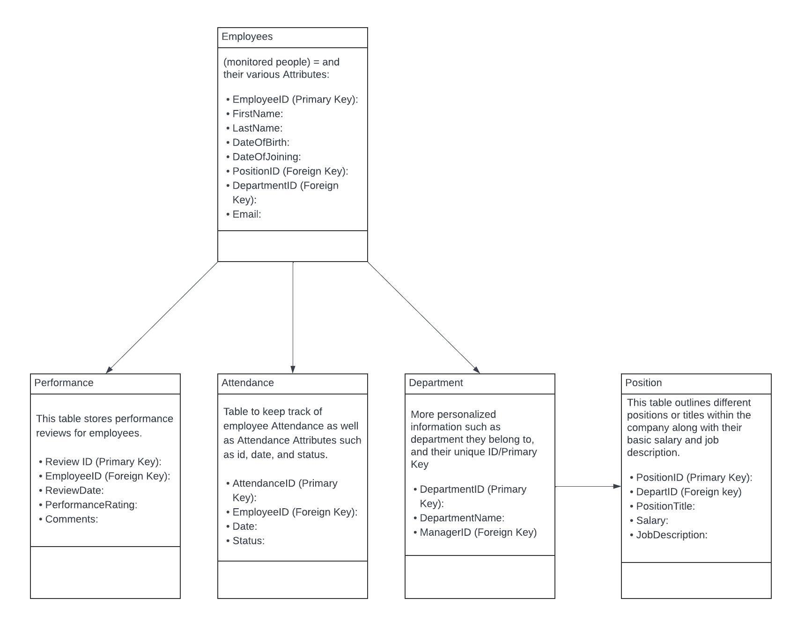
UML Diagram, (2023); Lucidchart.com

Slide 10

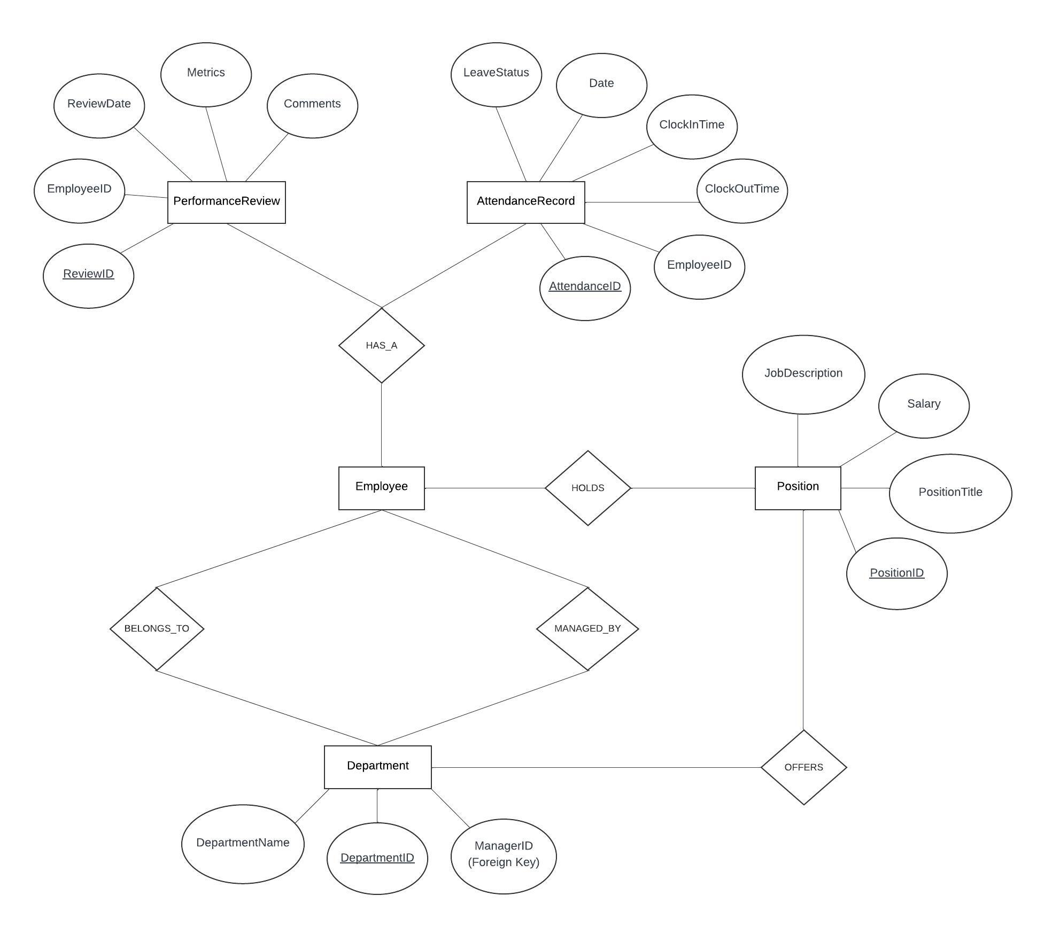
E-R Diagram, (2023); Lucidchart.com

Slide 11

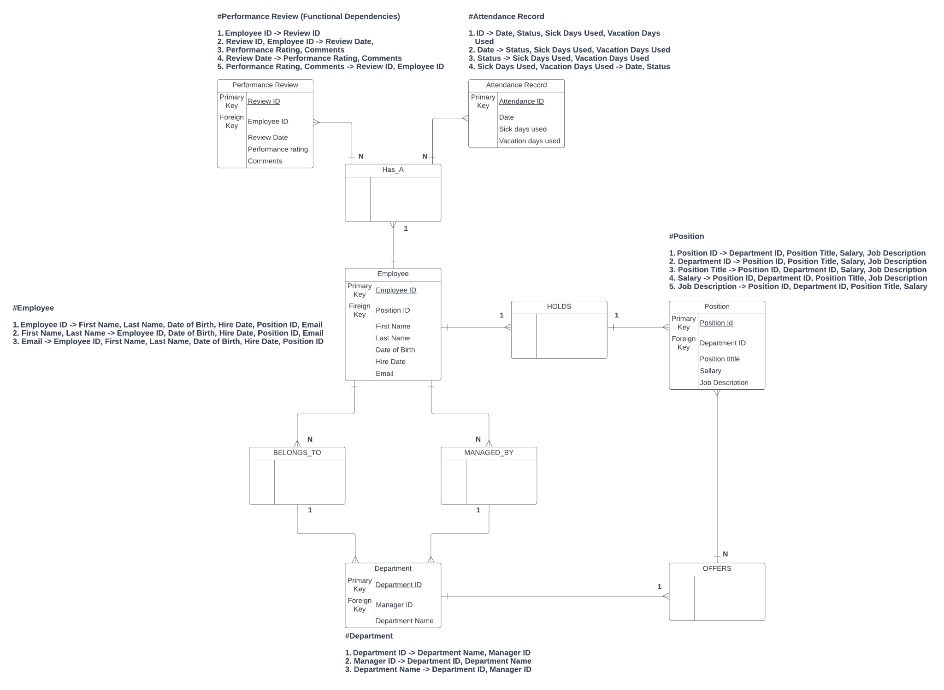
Relational Model Diagram “with dependencies”, (2023); Lucidchart.com

Slide 12

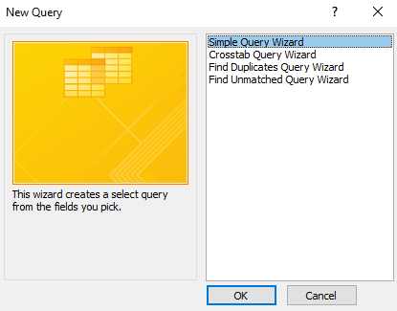
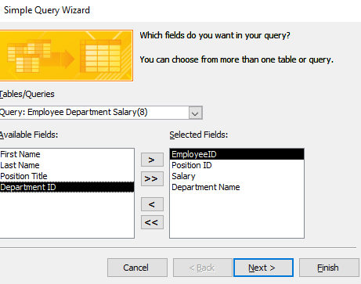
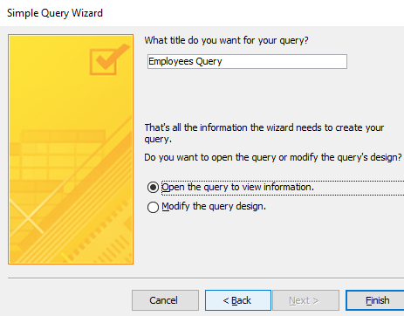
QUERY CREATION
Step 1:
Use the query wizard to create a blank query.
Step 2:
Select the fields required for the query you want to make
Step 3:
Finalizing the query creation process

Slide 13

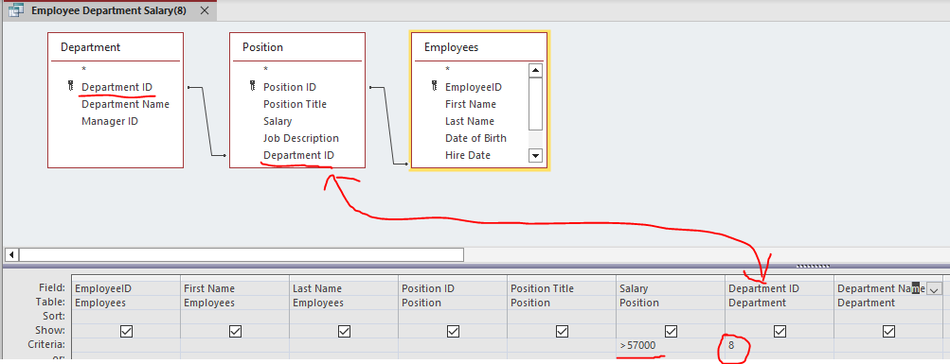
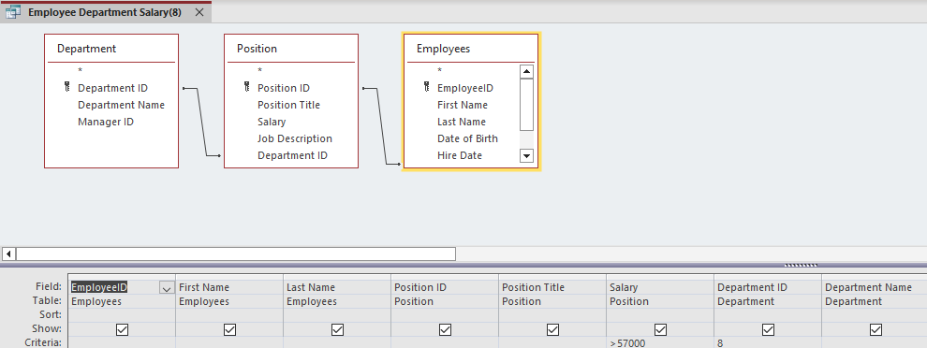
Query Creation Process
Step 4: determine the different tables used in each query
Step 5: Determine values in order to get desired output

Slide 14
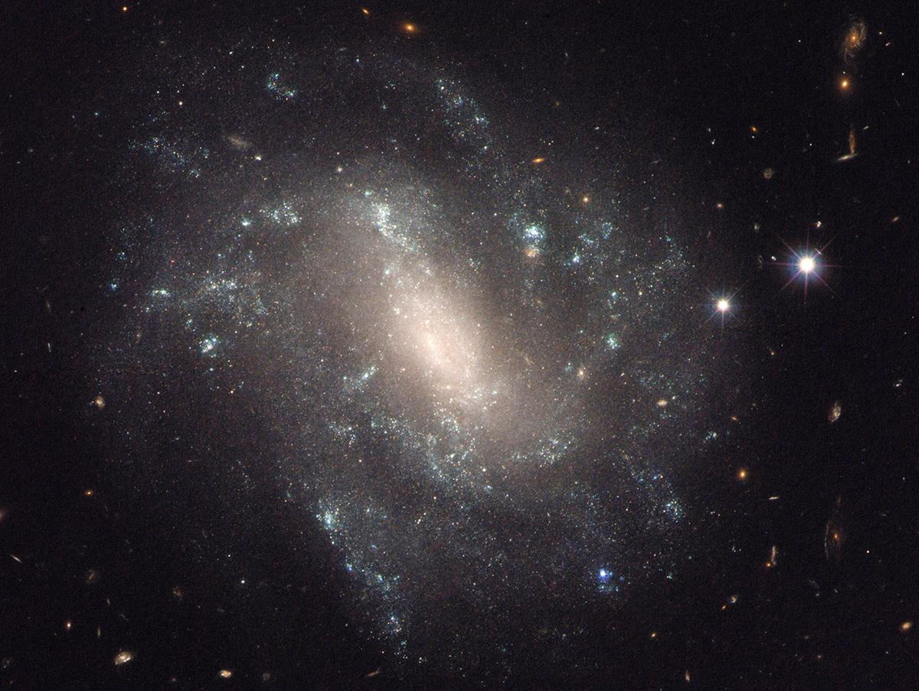
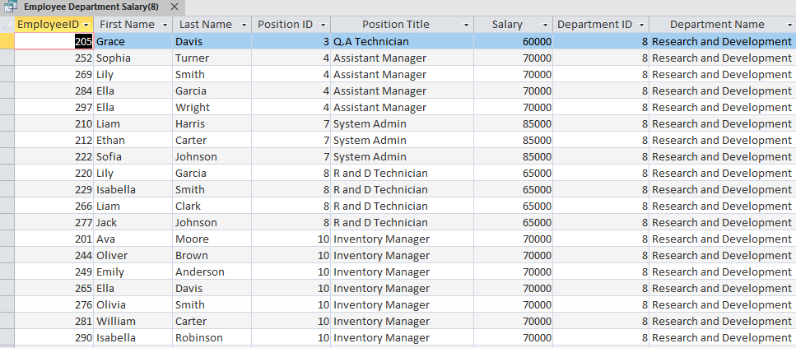
Final product of query:
Functional, actionable data

Slide 15
Questions?

